Slide 1
Women in Political Offices in Nigeria: Progress or Plateau?
A 2007–2023 Analysis of Gender Representation in Nigerian General Elections.
Agu Confidence, Oluwatosin Sanyaolu, Ebere Adirika, Olagboyega Stephanie, Ajekwe Nkemakonam.
Group 1 – Data Analysis,
July 2025

Slide 2
Introduction
Brief: Women remain significantly underrepresented in Nigerian politics due to structural, social, and cultural barriers. Though awareness has grown, overall participation remains low.
Purpose of the Study: To assess the trend of women's political participation in Nigeria from 2007 to 2023 and determine whether there has been meaningful progress or a plateau.
Importance of Gender Equity in Politics: Equitable representation ensures inclusive policymaking, strengthens democracy, and reflects the diverse needs of society.
Scope of the Study: This study focuses on gender-based electoral data from 2007 to 2023, analyzing the number and percentage of female candidates in general elections across Nigeria.

Slide 3
Methodology
Data Sources:
Primary Data - Structured responses from an online Google Form survey with over 70 participants. Secondary Data: INEC official reports and gender-disaggregated political data from 2007 to 2023 general elections.
Timeframe:
Scope of Analysis: 2007–2023 (General Elections in Nigeria).
Survey Period: June - July 2025 (2-week period of data collection).
Tools Used:
Microsoft Excel – Data cleaning, calculations, and dashboard creation.
Google Forms – Survey design and data collection.
PowerPoint – Visualization and final presentation.

Slide 4
Dashboard 1 & 2

Slide 5
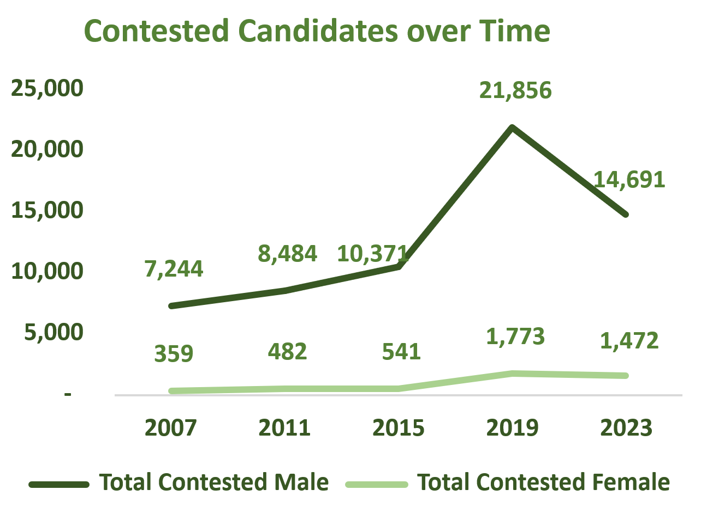
Total Candidates Trend (Male vs Female)
Female participation remained low across years.
Sharp dip in 2015, slight recovery in 2019.
Male candidates peaked in 2019, showing broader engagement.
The gender gap persists despite modest gains.

Slide 6
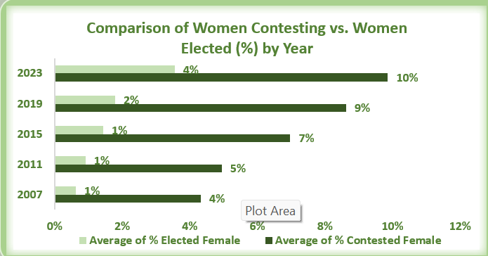
% Female Candidates by Year
Best Year: 2023
Highest % of Female Contestants: 10%
Highest % of Female Winners: 4%
This was the best-performing year across all elections, reflecting a growing momentum in women’s political participation.
Worst Year: 2007
Lowest % of Female Contestants: 4%
Lowest % of Female Winners: 1%
This was the year with the least female presence and success in politics, showing how far the journey has been.

Slide 7
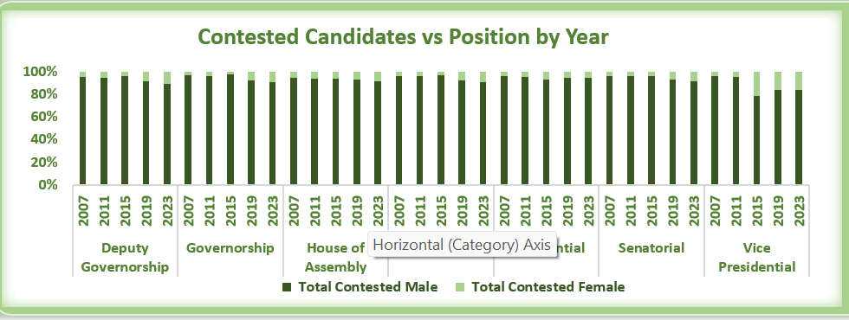
Elected Candidates by Gender
In 2023, Nigeria saw a modest improvement in female political participation, with a small increase in the number of women elected compared to previous election cycles. This indicates a gradual shift in public perception and growing advocacy for gender equity in governance.

Slide 8
2019 Candidates vs Elected Officials by Gender
Gender | Total Contestants | Elected | Not Elected
Male | 4710 | 1476 | 3234
Female | 552 | 44 | 508
Female candidates remain significantly underrepresented in elected positions despite contesting.

Slide 9
Progress or Plateau?
ELECTION YEAR | Total Contested Female | Total Elected Female | % Improvement for Contested Female | % Improvement for Elected Female
2007 | 359 | 24
2011 | 482 | 34 | 34% | 42%
2015 | 541 | 51 | 12% | 50%
2019 | 1773 | 44 | 228% | -14%
2023 | 1472 | 85 | -17% | 93%
% Improvement from 2007-2023 | 310% | 83%
Between the 2007 and 2023 general elections, there was a notable upward trend in female political participation. The number of contested female candidates increased by 310%, while the number of elected female candidates saw an 83% improvement.
However, this growth was not without fluctuations. A significant decline in the number of contested female candidates was observed in year 2023, and a similar dip in the number of elected female candidates occurred in 2019 year.

Slide 10
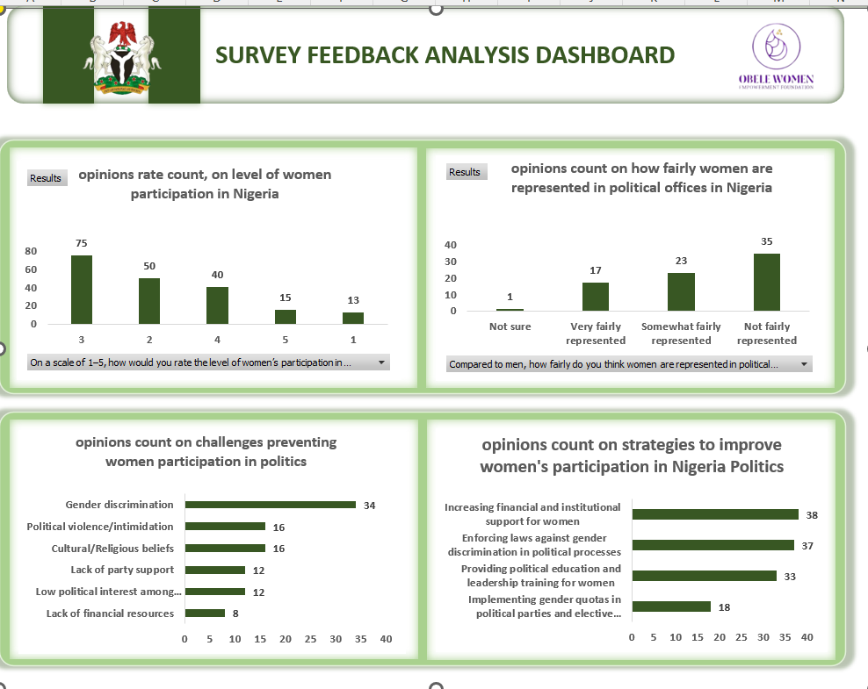

Slide 11
Recommendations (From Primary Data)
Increasing financial and institutional support for women
1
Enforcing laws against gender discrimination in political processes
2
Providing political education and leadership training for women
3

Slide 12
Conclusion
While more women are stepping into the political arena, their success at the polls remains disproportionately low. This highlights the urgent need for systemic reforms that go beyond candidacy, ensuring equitable support, visibility, and pathways to political office.

Slide 13
Thank you!
We welcome your questions.

